Slide 1
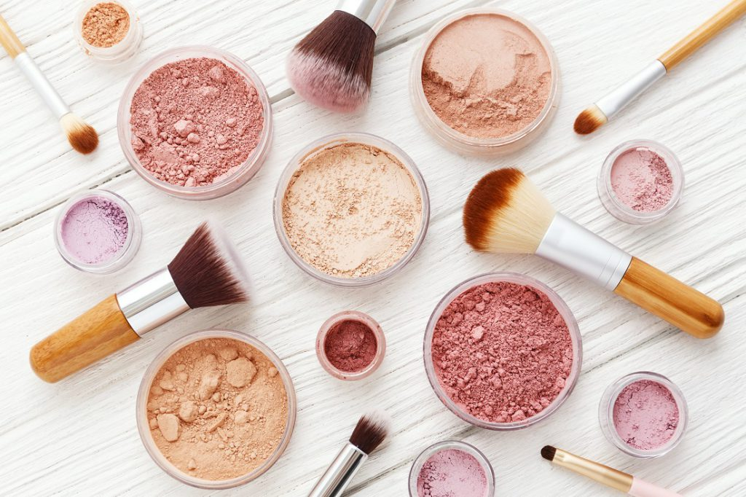
Effects of Makeup of Females on Males’ Willingness to Help
Team6
Yi Yu, Fernanda Lin, Haolan Ma, Xiaoqi Hu, Chenhang Niu

Slide 2

Females with makeup are more likely to receive help from men
?

Slide 3

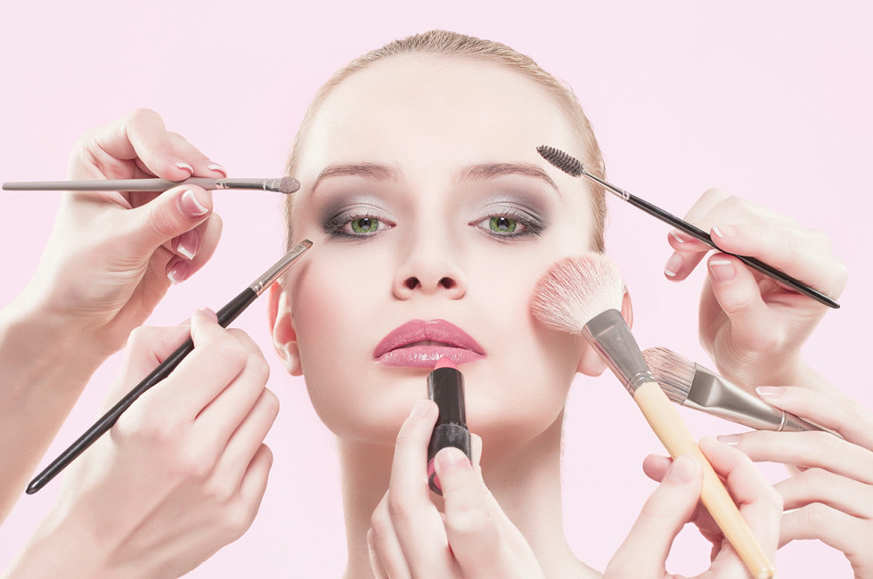
Without makeup

Slide 4
With makeup

Slide 5
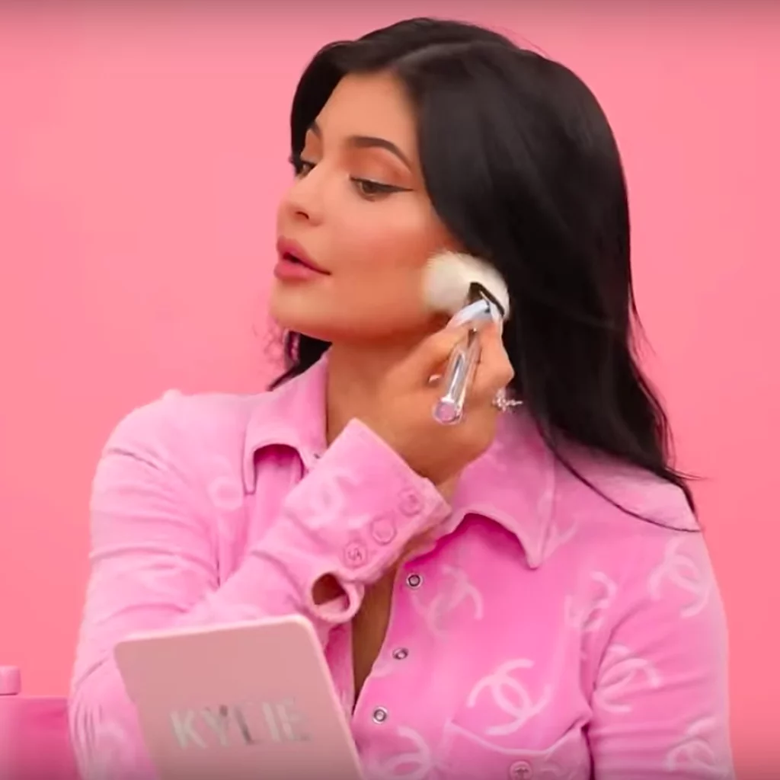
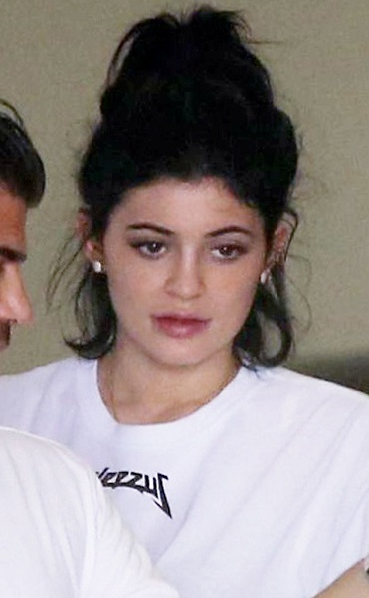
Experimental Design
Treatment
Makeup/
No Makeup
Outcome
Did the stranger male participant borrow their phone?
Other Measurements
Estimated age
Race
Rush or Not
Unit of Randomization
Individual level, asked each male participant to borrow phone
Time and Location
Nov 23rd, 2019 10 am & 2 pm; Kenmore/Fenway and Kendall/Harvard Square
Non-inference
Waiting 5 minutes or walking 400 meters radius distance
Notes:
IS THAT REALLY THE TRUTH? TODAY OUR EXPERIMENT WILL GIVE YOU THE ANSWER.
On november 23rd 2019, we conducted our experiment in two similar geographic locations, Kenmore/Fenway, and Kendall/Harvard Square, the reason we choice those two big areas is because both areas were considered as high in both student and professional population. We conducted this experiment into individual levels by asking male participants to borrow their phone. Also in order to prevent contamination between participants we introduce an 5-10 mins walking radius gaps between each participant.
Our treatment is either tester has makeup on her face or not, and the outcome will be whether they borrowed an phone from the male or not. Lastly we also try to observe participants’ age, race and whether they rush or not.

Slide 6
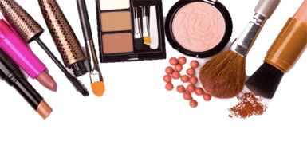
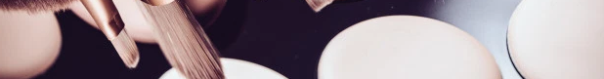
Implementation
Female experimenter approached stranger male participants chosen randomly with or without makeup
Asking if she can borrow his personal phone
“Hi, excuse me! My phone is out of charge, could I borrow your phone to make a quick phone call?”
Recorded outcome, exact time and observed race, age of the participant and whether he is in a rush

Slide 7
Implementation
Region 1
Region 2
 | Kenmore | Fenway | Harvard | Kendall
Morning | Control (Experimenter A) | Treatment (Experimenter B) | Control (Experimenter C) | Treatment (Experimenter D)
Afternoon | Treatment (Experimenter A) | Control (Experimenter B) | Treatment (Experimenter C) | Control (Experimenter D)

Slide 8
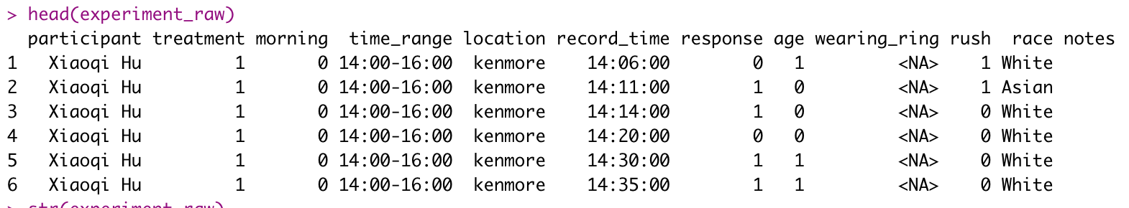
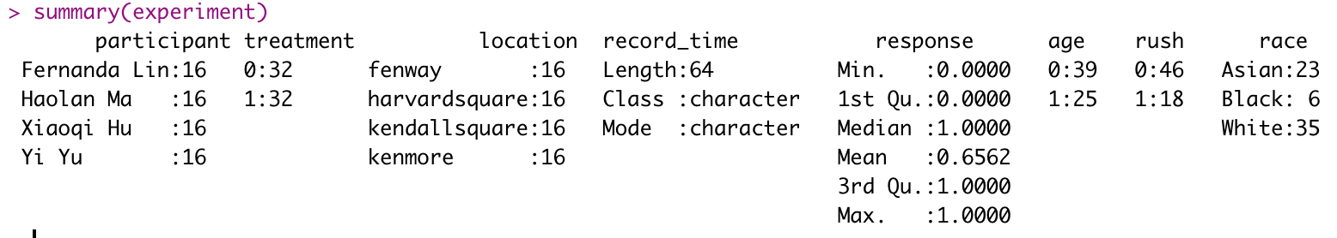
Data Collection

Slide 9
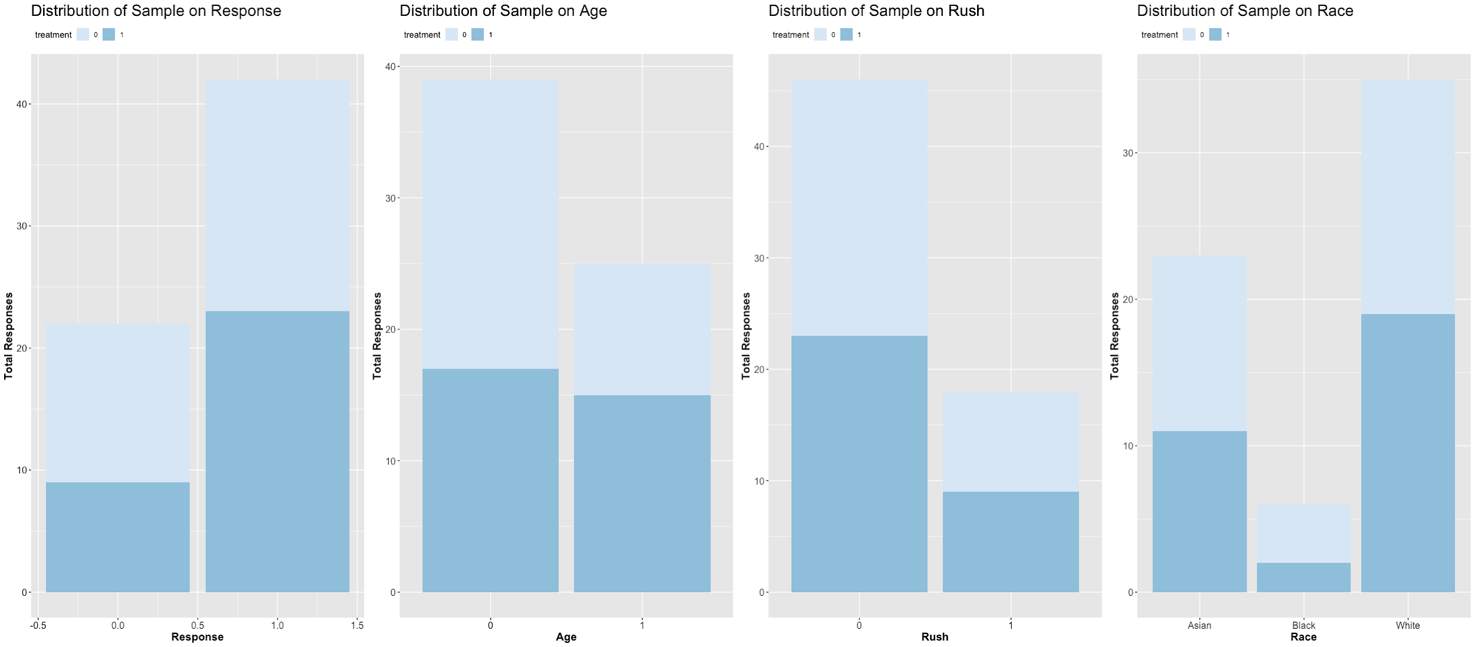
Summary Statistics & Randomization Check

Slide 10
Experiment Regression Models
The Effect of the Treatment
The Effect of the Treatment with Fixed Effect of Record Time and Location
The Effect of the Treatment with Covariate Variables with Fixed Effect
Notes:
We run 3 experiment regression models, Since it’s hard to observe certain characteristics about locations and times which we want to control, so we decided to treat them as fixed effects. Our covariate variables, including rush, race, and age.

Slide 11
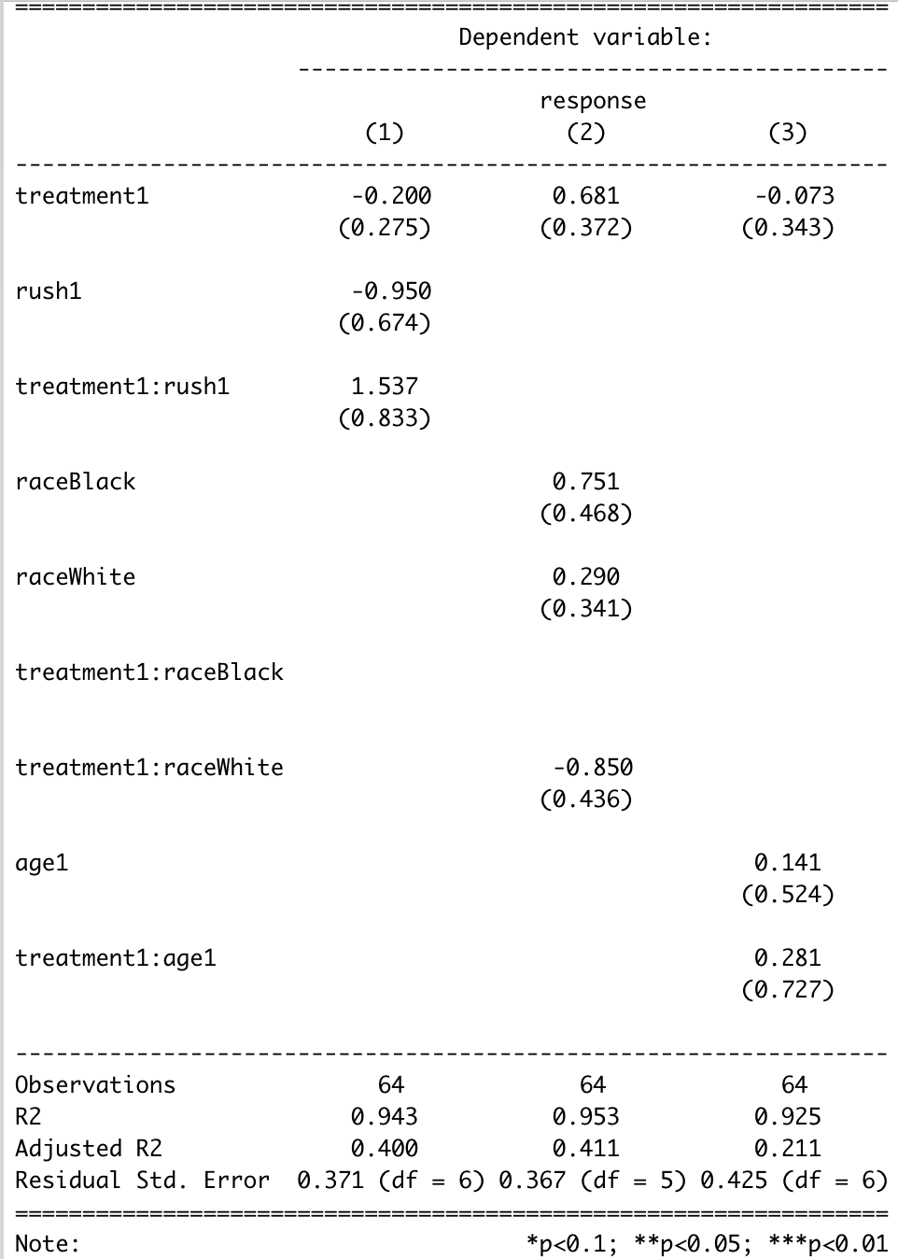
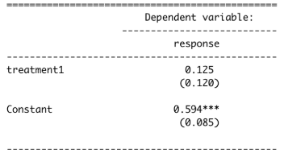
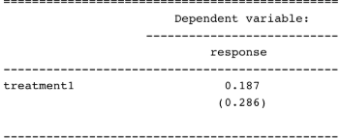
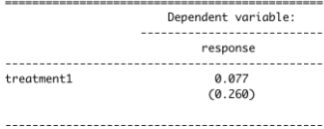
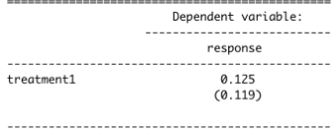
Results
Treatment on response
Treatment on response with time as fixed effect
Treatment on response with both time and location
Treatment on response with location as fixed effect
Insignificant!!!
Treatment on response with both time and location as fixed effect and covariate variables

Slide 12
Conclusion
Makeup of women does not have an effect on the willingness to help of a random male on the street.
Notes:
So as I just asked previously is that really the truth that males will be more willing to help a female who has makeup on.
Our answer according to the result of experiment is No.
So, Ladies feel free to asking for help on the street when you needed, even you don't have your makeups on.

Slide 13
Limitation
Lack of Information on Interactions
Small Sample Size
Unethical
Deception and Ignoring
Information Efficiency

Slide 14
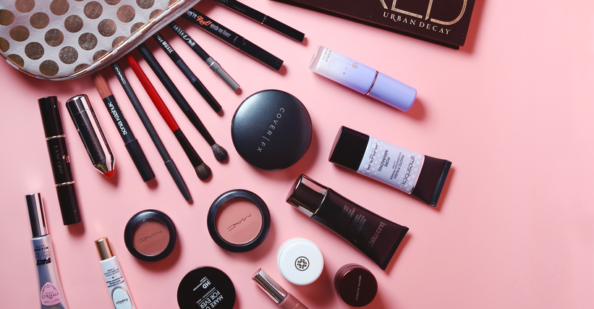
Thank You!

